Slide 1
Introduction to Angular
Setting the scene
Creating an application
Understanding the application

Slide 2
Section 1: Setting the Scene
What is Angular?
Angular versions

Slide 3
What is Angular?
Angular is a client-side framework from Google
Makes it easier to develop large-scale rich Web apps
How does Angular help?
Client-side data binding
Routing
Dependency injection and services
REST integration
For full details, see https://angular.io/docs
3

Slide 4



Angular Versions
…
n
4

Slide 5
Section 2: Creating an Application
Overview of Angular CLI
Getting Angular CLI
Angular CLI capabilities
Creating an application
Reviewing the application
Serving the application
Viewing the application

Slide 6
Overview of Angular CLI
Angular CLI is a command-line interface tool that you can use to create a new Angular application
Scaffolds a complete template application
Generates appropriate config files
Reinforces best practices for file names, folders, etc.
Angular CLI also has commands to generate new artifacts in a standardised way
Components, services, directives, etc.
6

Slide 7
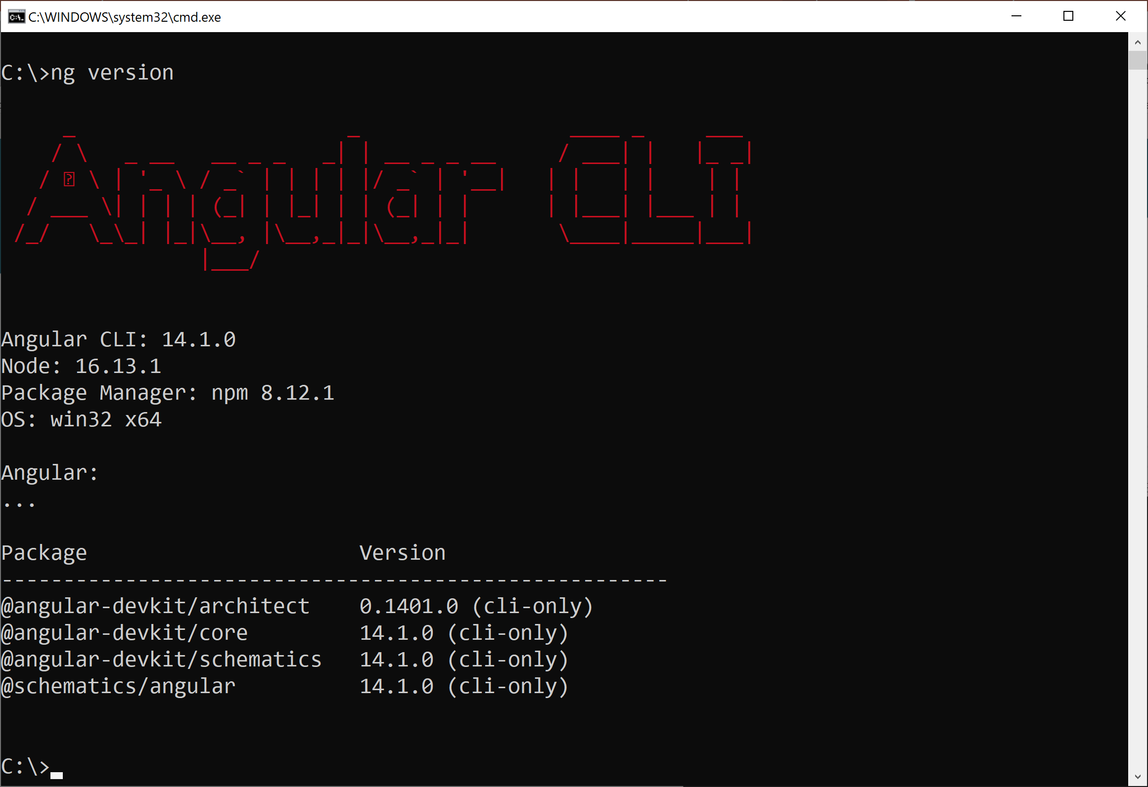
Getting Angular CLI
Angular CLI is a Node.js application
You must install Node.js first (version 14 or above)
You can install Angular CLI on your machine as follows:
You can verify the version of Angular CLI installed:
npm install -g @angular/cli
ng version
7

Slide 8
Angular CLI Capabilities
Once you'll installed Angular CLI, it enables you to:
Create a new application
Add artifacts to the application
Serve an application, i.e. host in a server
Build an application into bundled files
Angular CLI is currently version 14 (as of June 2022)
The Angular version is incremented every 6 months
8

Slide 9
Creating an Application
To create an Angular application using Angular CLI…
Run the following command from the command line:
You'll be asked a few questions:
Would you like to add Angular routing? (choose No)
Which stylesheet format would you like? (choose CSS)
ng new DemoApp
9

Slide 10
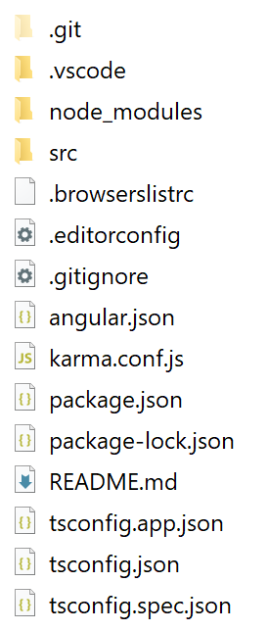
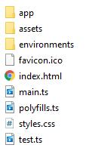
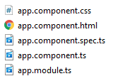
Reviewing the Application
Angular CLI creates a fully functional Angular app with minimalistic functionality:
src folder
src/app folder
10

Slide 11
Serving the Application
To serve the application:
Go to the application folder
Run the following command:
This command builds and serves the app in memory
Default host is localhost, default port is 4200
Use --host and --port for a different host and port
ng serve
11

Slide 12
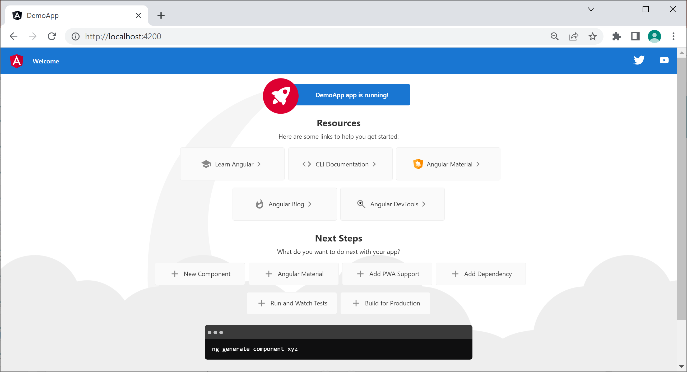
Viewing the Application
To view the app, browse to http://localhost:4200
The app automatically reloads if you change source files
12

Slide 13
Aside: Updating an Existing App
Angular comes out with a new version every 6 months
If you have an existing Angular app that you want to update to Angular 14:
Uninstall your (old) version of Angular CLI
Then install the latest version of Angular CLI
Then run the following command:
ng update @angular/core @angular/cli --allow-dirty
13

Slide 14
Section 3: Understanding the Application
Overview
Key configuration files
Application home page
Main source file
Module source file
Component source files
Additional techniques

Slide 15
Overview
Angular applications have a lot of moving parts
There are a lot of config files and source files…
We'll take a quick journey through some of the key details in this section (details follow later in the course)
Config files
Application home page
Source code files (in TypeScript)
15

Slide 16
Key Configuration Files
package.json
Specifies Node.js dependencies (e.g. Angular libraries)
Specifies development tools (e.g. TypeScript transpiler)
Specifies command-line scripts (e.g. ng serve)
tsconfig.json
Configures the TypeScript transpiler
angular.json
Specifies application home page, src/index.html
Specifies main source file, src/main.ts
16

Slide 17
Application Home Page
Here's the application home page:
When the application is launched:
The <app-root> element is populated with content generated by our Angular application code
<!doctype html>
<html lang="en">
<head> … </head>
<body>
<app-root></app-root>
</body>
</html>
src/index.html
17

Slide 18
Main Source File
Here's the main source file in our application:
Launches AppModule, the "module" for our app
See next slide for the definition of AppModule
import { enableProdMode } from '@angular/core';
import { platformBrowserDynamic } from '@angular/platform-browser-dynamic';
import { AppModule } from './app/app.module';
import { environment } from './environments/environment';
if (environment.production) {
enableProdMode();
}
platformBrowserDynamic().bootstrapModule(AppModule)
.catch(err => console.error(err));
src/main.ts
18

Slide 19
Module Source File
Here's the code for AppModule:
AppModule contains our application components etc.
It also designates the "bootstrap" (top-level) component
import { NgModule } from '@angular/core';
import { BrowserModule } from '@angular/platform-browser';
import { AppComponent } from './app.component';
@NgModule({
declarations: [AppComponent],
imports: [BrowserModule],
providers: [],
bootstrap: [AppComponent]
})
export class AppModule { }
src/app/app.module.ts
19

Slide 20
Component Source Files
In Angular, a component is a class that renders HTML
Instance variables - Data to display
templateUrl - HTML page to render the data
selector - Where to render the HTML
styleUrls - Optional CSS style sheet(s)
import { Component } from '@angular/core';
@Component({
selector: 'app-root',
templateUrl: './app.component.html',
styleUrls: ['./app.component.css']
})
export class AppComponent {
title = 'DemoApp';
}
src/app/app.component.ts
20

Slide 21
Additional Techniques
HTML template:
You can use the template property, for inline HTML
Use backticks (for ES6 interpolated strings)
Use {{xxx}} for Angular data binding expressions
CSS styles
You can use the styles property, for inline CSS styles
template: `<h1>The title is {{title}}</h1>`
styles: ['h1 { font-family: Verdana; color: red }']
21

Slide 22
Summary
Setting the scene
Creating an application
Understanding the application

